Slide 1


Department of Computer Science University of Bristol
COMSM0086 – Object-Oriented Programming with Java
Iterator Design Pattern
Simon Lock | simon.lock@bristol.ac.uk. Sion Hanunna | sh1670@bristol.ac.uk
Notes:
Layer of indirection – getter and setters virtual memory, strategy pattern
Wiki: the strategy pattern (also known as the policy pattern) is a behavioral software design pattern that enables selecting an algorithm at runtime. Instead of implementing a single algorithm directly, code receives run-time instructions as to which in a family of algorithms to use.

Slide 2
This thing …
for(String s : strings){
System.out.println (s);
}

Slide 3
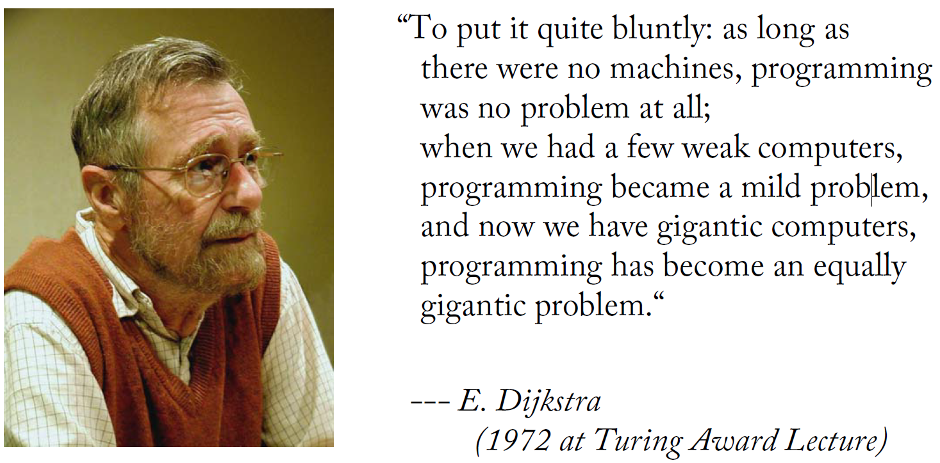
“…simplicity and elegance are unpopular because they require hard work and discipline to be achieved, and education to be appreciated...”
`

Slide 4

“All problems in computer science can be solved by another level of indirection”
--- Butler Lampson
Notes:
By increasing the level of abstraction one can make the problem easier to understand/resolve.
Virtual memory
References
Dynamic dispatch
…except for the problem of too many levels of indirection," referring to the fact that too many abstractions may create intrinsic complexity issues of their own. For example, the use of protocol layering in computer networks, which today is ubiquitous, has been criticized in ways that are typical of more general disadvantages of abstraction.^{[3]}

Slide 5


Interfaces vs. Concrete Implementations

Slide 6
Interfaces vs. Implementations .
class ArraySet<X> implements Set<X> {
protected X[] values;
protected int size;
private final int N = 100;
public ArraySet() {
values = (X[]) new Object[N];
size = 0; }
@Override
public void insert(X x) {
assert(size<100); assert(!contains(x));
values[size] = x;
size = size + 1; }
@Override
public void delete(X x) {
assert(contains(x));
for (int i=0; i < size; i = i+1) {
if (values[i].equals(x)) {
values[i] = values[size-1];
size = size - 1;
break;
} } }
@Override
public boolean contains(X x) {
boolean contains = false;
for (X value : values) {
if (value.equals(x)) {
contains = true;
break;
} }
return contains; }
@Override
public int size() {
return size; }
@Override
public void empty() {
size = 0;
} }
the role of an interface (e.g. a Set) is to provide a contract
any particular concrete implementation (e.g. ArraySet) has to fullfill it
an interface does not force a particular way of realising this contract
interface Set<X> {
public void insert(X x);
public void delete(X x);
public void empty();
public boolean contains(X x);
public int size();
}
What?
How?
interface Set provides a representation-independent contract, which all concrete implementations have to realise
ArraySet implements all methods demanded by the interface Set and specifies a particular, concrete representation of all state and behaviour required

Slide 7

Inner Classes

Slide 8
Inner Classes and Anonymous Classes
inner classes (or inner interfaces too) are defined within another class (the outer class)
anonymous (inner) classes are defined and instantiated in a single expression using new, where the anonymous class definition itself is actually an expression
it can be included as part of a larger expression, such as a method call
inner classes are often local helper classes, whilst anonymous classes are often use-once classes without an explicit handle to the code that defines it
an inner interface
public class AnonymousWorld {
interface HelloWorld {
public void say();
}
public static void sayHello() {
class EnglishGreeting implements HelloWorld {
public void say() {
System.out.println("Hello!");
} }
HelloWorld sayEnglish = new EnglishGreeting();
HelloWorld sayGerman = new HelloWorld() {
public void say() {
System.out.println("Hallo!");
} };
sayEnglish.say();
sayGerman.say();
}
public static void main(String... args) {
sayHello();
} }
public class AnonymousWorld {
interface HelloWorld {
public void say();
}
public static void sayHello() {
class EnglishGreeting implements HelloWorld {
public void say() {
System.out.println("Hello!");
} }
HelloWorld sayEnglish = new EnglishGreeting();
HelloWorld sayGerman = new HelloWorld() {
public void say() {
System.out.println("Hallo!");
} };
sayEnglish.say();
sayGerman.say();
}
public static void main(String... args) {
sayHello();
} }
a static method
an inner class
instantiation of the inner class
an anonymous inner class, definition together with instantiation
saying ‘Hello’
saying ‘Hallo’
call static method

Slide 9

Iterators

Slide 10
This thing …
for(String s : strings){
System.out.println (s);
}

Slide 11
The Concept of Iterators
class ArraySet<X> implements Set<X> {
protected X[] values;
protected int size;
private final int N = 100;
public ArraySet() {
values = (X[]) new Object[N];
size = 0; }
@Override
public void insert(X x) {
... values[size] = x;
size = size + 1; }
@Override
public void delete(X x) {
assert(contains(x));
for (int i=0; i < size; i = i+1) {
if (values[i].equals(x)) {
values[i] = values[size-1];
size = size - 1;
break;
} } }
@Override
public boolean contains(X x) {
boolean contains = false;
for (X value : values) {
if (value.equals(x)) {
contains = true;
break;
} }
return contains; }
@Override
public int size() {
return size; }
@Override
public void empty() {
size = 0;
} }
various object structures hold elements: e.g. sets, arrays, lists, trees (e.g. ArraySet on left)
we often want to be able to iterate over all the elements independent of the structure
Java has an Iterator interface to do this (see the JavaDocs for all details)
classes need to implement Iterable to be iterated over using the : notation, the interface demands to be able to get hold of an Iterator object to drive it
Can we make our ArraySet iterable?
Iterable promises to provide an Iterator
extending the ArraySet to add functionality to iterate over
extending the ArraySet to add functionality to iterate over
extending the ArraySet to add functionality to iterate over
import java.lang.Iterable;
import java.util.Iterator;
class IterableArraySet<X>
extends ArraySet<X>
implements
Iterable<X> {
@Override
public Iterator<X> iterator() {
return new Iterator<X>() {
private int index = 0;
public X next () {
X x = values[index];
index = index + 1;
return x;
}
public boolean hasNext() {
return (index < size);
} };}
}
import java.lang.Iterable;
import java.util.Iterator;
class IterableArraySet<X>
extends ArraySet<X>
implements
Iterable<X> {
@Override
public Iterator<X> iterator() {
return new Iterator<X>() {
...
} }; }
}
import java.lang.Iterable;
import java.util.Iterator;
class IterableArraySet<X>
extends ArraySet<X>
implements
Iterable<X> {
...
} }
interface to implement
interface to implement
interface to implement
interface Iterable<E> {
public Iterator<E> iterator();
...} // shipped with Java
class IteratorWorld {
public static void main (
String[] args) {
int sum = 0;
...
IterableArraySet<Integer> set =
new IterableArraySet<>();
set.insert(1);
set.insert(2);
...
for (Integer i : set) {
sum += i.intValue();
System.out.println(i);
}
System.out.println(sum);
} }
interface Iterator<E> {
public boolean hasNext();
public E next();
...} // shipped with Java
simple for-loop to iterate through the set
Iterator defined as anonymous
class
Iterator defined as anonymous
class
interface Set<X> {
public void insert(X x);
public void delete(X x);
public void empty();
public boolean contains(X x);
public int size();
}
an Iterator provides all methods needed to step through all elements of a collection

Slide 12
The Iterator Pattern in Detail
SYNOPSIS
UML
code
comments
interface Iterable<X> {
public Iterator<X> iterator();
} // shipped with Java
collection becomes ‘Iterable’ once an Iterator for it can be retrieved
interface Iterator<X> {
public boolean hasNext();
public X next();
} // shipped with Java
interface Set<X> {
public void insert(X x);
public void delete(X x);
public void empty();
public boolean contains(X x);
public int size();
}
<interface> Iterable <X>
<interface> Iterator <X>
+ Iterator<X> iterator()
+ X next()
+ boolean hasNext()
class ArraySet<X> implements Set<X> { protected X[] values;
protected int size;
...
}
Iterator has to know how to step through all elements
class IterableArraySet<X>
extends ArraySet<X>
implements
Iterable<X> {
@Override
public Iterator<X> iterator() {
return new Iterator<X>() {
private int index = 0;
public X next () {
X x = values[index];
index = index + 1;
return x;
}
public boolean hasNext() {
return (index < size);
} };}
}
class IterableArraySet<X>
extends ArraySet<X>
implements
Iterable<X> {
@Override
public Iterator<X> iterator() {
return new Iterator<X>() { ...}; } }
Collection <X>
CollectionIterator <X>
class IteratorWorld {
...
IterableArraySet<Integer> set =
new IterableArraySet<>();
set.insert(1);
set.insert(2);
sum = 0;
for (Integer i : set) {
sum += i.intValue();
System.out.println(i);
}
System.out.println(sum);
} }
The Iterator pattern is used to provide a standard interface for traversing a collection of items in an aggregate object without the need to understand its underlying structure. [GoF]
Notes:
Solid arrow with normal head is association: CollectionIterator has a direct reference to the Collection
Dashed arrow is dependency Collection is dependent on CollectionIterator

